Slide 1
Hacking Cordless phones and DECT

Slide 2
WHY?
This technology has been around for a long time but is often overlooked in modern information security.
Old-time hackers and radio enthusiasts know this technology has its pit falls. But many people don’t realize how bad it is.
Previously, physical radio equipment was needed.

Slide 3
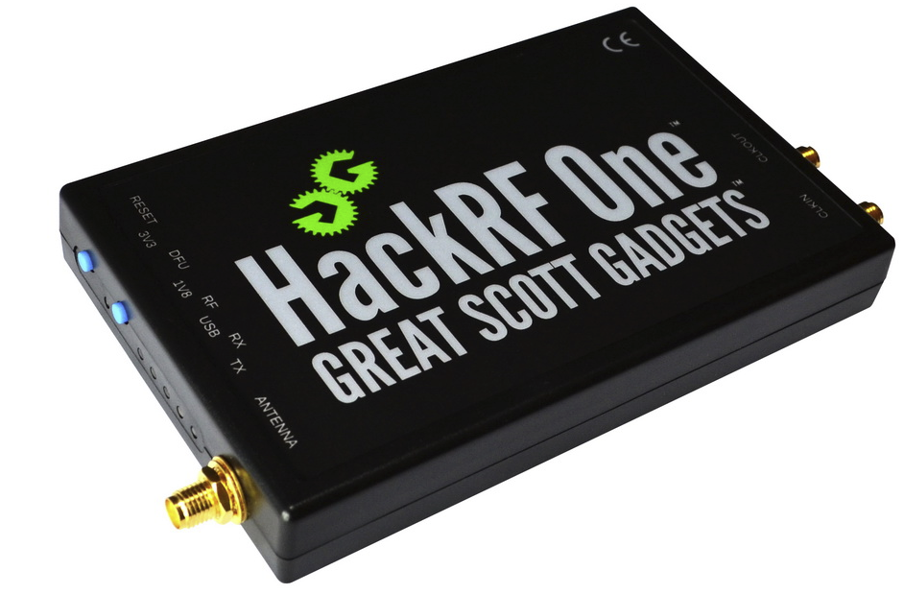
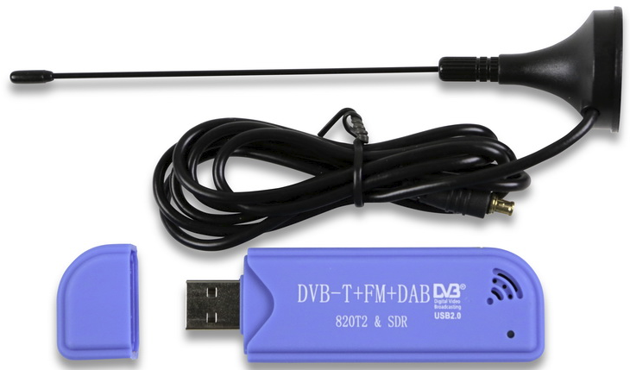
SDR: Software Defined Radio
With the creation of Software-Defined-Radio, it is easier now than ever.
SDR is radio that is defined by software, not hardware. Antennas support wide ranges and software is created to decode protocol at frequencies that fall within the supported range of the antenna.

Slide 4
Ethics and Legality
Ethics – As always, don’t perform attacks of eavesdrop on technology and communications you do not own. Receive permission before performing these attacks on willing parties. I am not a lawyer and this not is not legal advice.
Wire-Tapping (California): It is a crime in California to intercept or eavesdrop upon any confidential communication, including a telephone call or wire communication, without the consent of all parties.
FCC Jamming Prohibition: The use of "cell jammers" or similar devices designed to intentionally block, jam, or interfere with authorized radio communications (signal blockers, GPS jammers, or text stoppers, etc.) is a violation of federal law. Also, it is unlawful to advertise, sell, distribute, or otherwise market these devices to consumers in the United States. These devices pose serious risks to critical public safety communications, and can prevent you and others from making 9-1-1 and other emergency calls. Jammers can also interfere with law enforcement communications. Operation of a jammer in the United States may subject you to substantial monetary penalties, seizure of the unlawful equipment, and criminal sanctions including imprisonment.

Slide 5
Lawful Interception
Law enforcement agencies with court orders or other legal authorization to selectively wiretap individual subscribers.
1968 Omnibus Crime Control and Safe Streets Act, Title III
1978 Foreign Intelligence Surveillance Act, Amended by PATRIOT ACT
1994 Communications Assistance for Law Enforcement Act (CALEA)
2001 PATRIOT ACT, Section 215 Allowed NSA to call connection metadata. (Section 215 was amended to stop the NSA's collection)

Slide 6
SDR Used
The lower ~50 MHz phone is a lower frequency for many SDR Antennas, compared to the higher frequency of other phones.
I will be using the $20 RTL-SDR receiver (RTL 2832U/R820T), 24 – 1750MHz.
The $50 RTL-SDR (E4000) receiver is also supported by some of the tools used later, 55 -2300MHz.
I will also be using the $300 HackRF One half-duplex transceiver, 1 – 6000 MHz.

Slide 7
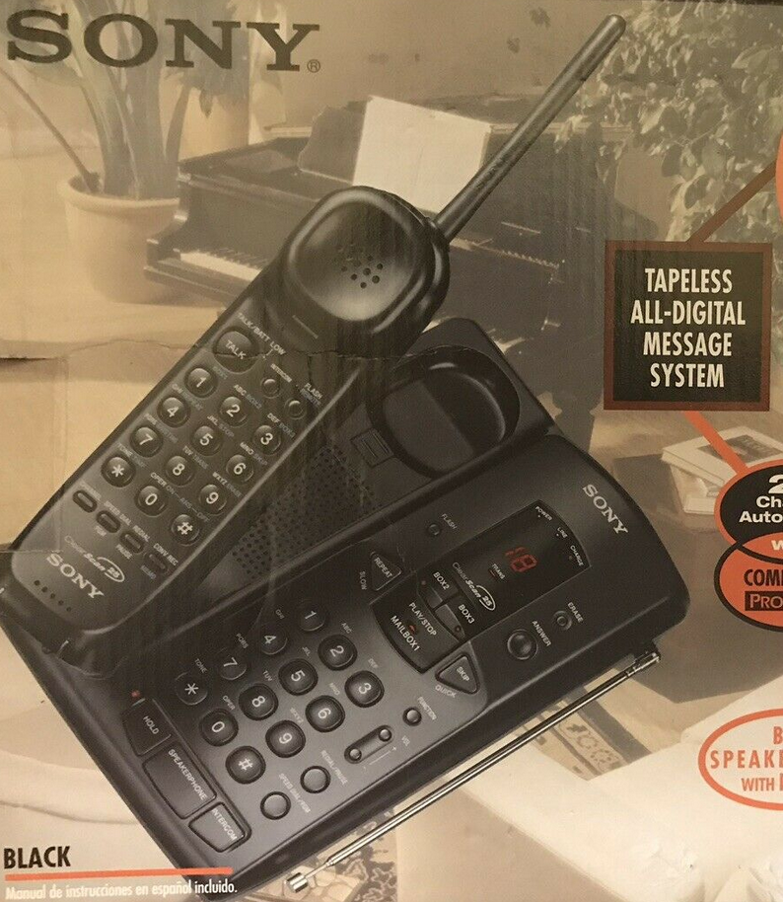
Target Phone #1: Sony SPP-AQ600
Released in 1996
43 – 46 MHz (Base Phone)
48 – 49 MHz (Handset)
25 Channels
Analog, FM Duplex
FCC ID: AK8SPPQ150
Very little information from FCC ID :(

Slide 8
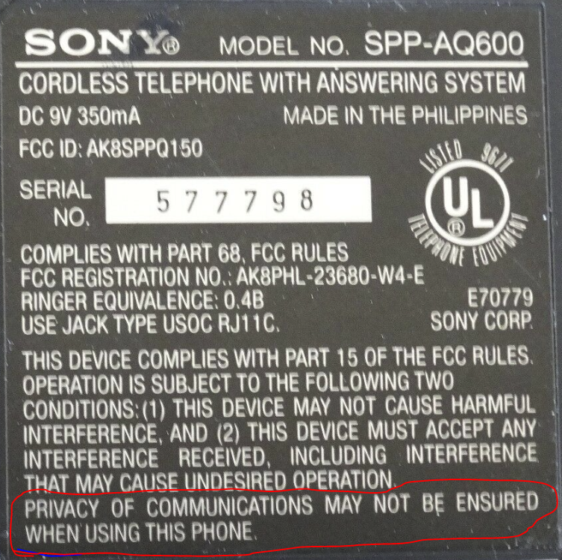
Target Phone #1: Sony SPP-AQ600
Nice to know, thanks Sony

Slide 9
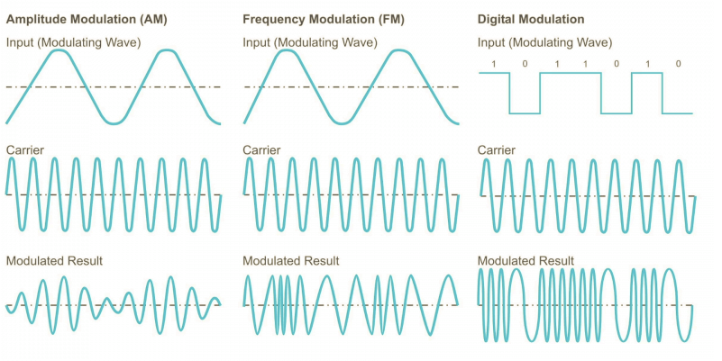
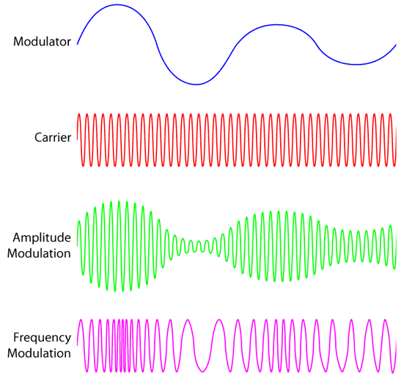
Modulation
Our Sony phone communicates using frequency modulation. A carrier wave will be be the signal used to transfer the data we want to send.

Slide 10
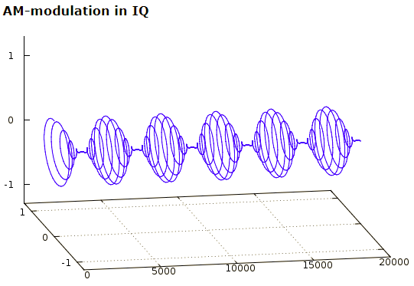
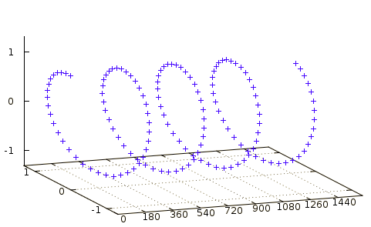
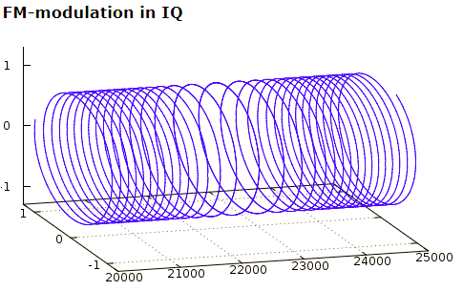
Modulation in 3 Dimensions
Images from: http://whiteboard.ping.se/SDR/IQ

Slide 11
Spectrum analyzer
I will be using a spectrum analyzer to listen view the Radio spectrum.
I am using SDR# for Windows.
GQRX works great for Linux and OS X.

Slide 12
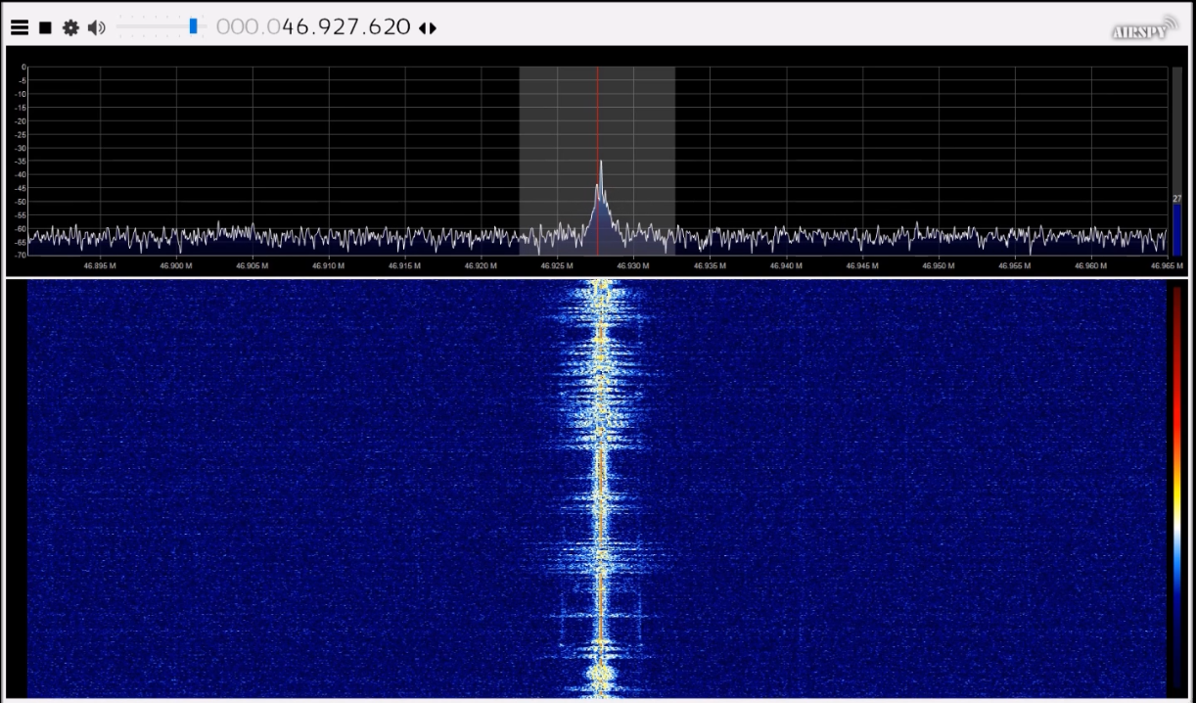
Analog Eavesdropping

Slide 13
Other Attacks
Signal Jamming – We could disrupt the conversation by creating noise on the same frequency of the call. Signal jamming is illegal in the U.S.
Replay Attacks – We can capture frequency data and replay it, such as dailing numbers, paging the phone, and prematurely ending the call.
Forced Pairing – Most phones support adding addition phones to them. A security code is used to pair compatible phones to the base station. This code could be brute forced to forcefully pair another phone the base station and make calls.

Slide 14
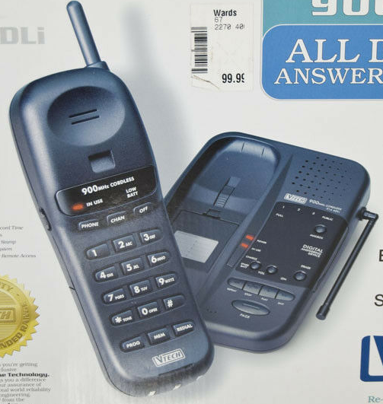
Target Phone #2: VTech 914 ADLi
Released 1997
925.05 – 927.75 MHz (Handset to Base)
902.3 – 905.0 MHz (Base to Handset)
20 Channels
Modulation FM?
FCC ID: EW780-4014-B4
Very little info from FCC ID :(
Still analog apparently

Slide 15
Digital Communication
With digital communication, the data is encoded into 0s and 1s and then is modulated. If we were to tune to that frequency, we would not be able to hear the voice communication without decoding it first.
May other digital phones used frequencies of 900 MHz, 2.4 GHz, and 5.8GHz.
Some vendors (like Vtech) are slightly misleading of what frequencies the phones use. For example, an advertised 5.8GHz phone, uses only 5.8GHz for communication from the phone to the base station, but the base station uses 900MHz to communicate back the phone.

Slide 16
What is DECT
DECT stands for Digital Enhanced Cordless Telecommunications, and originated from Europe replacing older analog standards like CT1 and CT2 (900MHz).
In the United States it is known as DECT 6.0 and operates a 1.9GHz, and was approved by the FCC in 2005. Prior to 2005, many digital phones used the unlicensed bands like 2.4GHz and 900MHz.
Mostly used for domestic cordless telephony, but is used elsewhere.

Slide 17
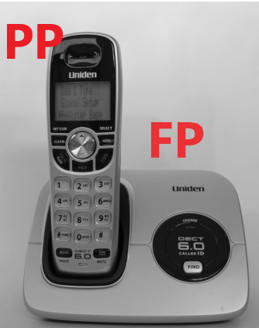
DECT Technical Stuff
DECT networks consists of Fixed Part (base station, also called Radio Fixed Part, FP/RFP) and one or more Portable Parts (mobile device, PP). DECT can support up to 12 PP for each FP. DECT’s range is ~160 feet indoors and ~1000 feet outdoors (line of sight).
The Generic Access Profile (GAP) is the most commonly used DECT profile. It defines telephony service operation of an air interface, regardless of back-end configuration.

Slide 18
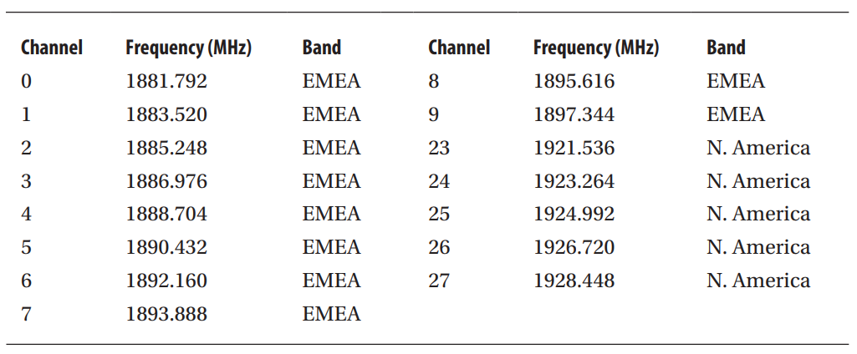
DECT Technical Stuff
DECT operates in the 1.88 –1.90 MHz band For Europe, Middle East, and Africa (EMEA), and uses 1.92 – 1.93 MHz for North America. EMEA has 10 frequency channels, while the North America has 5. Each channel has a band gap of 1728 kHz.

Slide 19
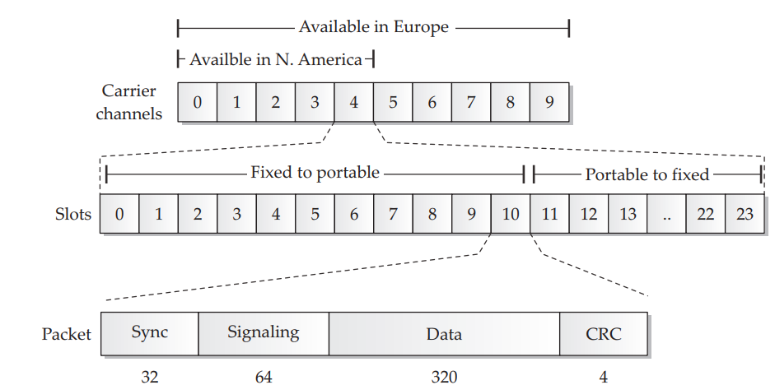
DECT Technical Stuff
Each of the channels is then split into 24 slots. 12 of these slots are for downlink communication (FP to PP), with the other 12 for uplink communications (PP to FP). There are 12 slots because each channel can support 12 con-current phones.
DECT Frames consist of 4 parts. The most important two are the A-Field (Signaling), which defines control characteristics-payload data type and network identifiers, and the B-Field (Data), which carries the voice of station data.

Slide 20
DECT Technical Stuff
Each FP will constantly broadcast its RFPI – Radio Fixed Part Identifier address information, used and available slots, system capabilities and status information. This is done to not confuse PP or other FPs. PPs will evaluate the RSSI – Radio Signal Strength Indicator – every 30 seconds to determine which FP is the best to use.
This information is stored in the A-Field and is not encrypted.
This means an attacker can easily perform DECT War-Driving, even if there is no active phone call.

Slide 21
DECT Security - Authentication
DECT supports authentication, however, it is not always enforced.
DECT Standard Authentication Algorithm (DSAA) is responsible for handling initial key exchange and key derivation function between the FP and PP and for subsequent device authentication based on derived key. Authentication proves both FP and PP are valid devices.
The DECT GAP profile is required to support DSAA.
DSAA is proprietary and was developed in secrecy with vendors, and was not open to peer review.

Slide 22
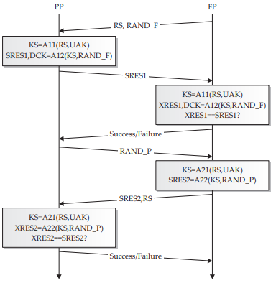
DECT Security - Authentication
For PP and FP to pair, a users enters a fixed security code + random numbers to derive the User Authentication Key (UAK). The UAK is used for authentication and encryption key derivation.
FP generates two 64 bit random crypto-variables, RS and RAND_F, and sends them to the PP.
Intermediate Key KS, is generated by RS and UAK passing throught the DSAA11 Algorithm. KS and RAND_F then pass through the DSAA12 algorithm to create Signed Response SRES1 And the Derived Cipher Key DSC. The DSC is saved locally on the the PP and is used for encrypting/decrypting traffic.
FP does the same thing but the SRES1 is called the XRES1. SRES1 and XRES1 should match. If so, PP is authenticated.
PP sends a random 64 bit crypto-variable RAND_P to the FP.
FP generates another RS and uses it and UAK through the DSAA21 algorithm to create a KS intermediate key. The new KS and RAND_P then go through the DSAA22 Algorithm to create the SRES2.SRES2 is send to the PP.
The PP does the same process and computes the new KS and XRES2, and verifies is the its XRES2 matches the FP’s XRES2. If so, the PP has been successfully authenticated.

Slide 23
DECT Security - Encryption
DECT supports encryption, though it rarely enforced. DECT Standard Cipher, is the encryption used.
DSC is proprietary and was developed in secrecy with vendors, and was not open to peer review. Reverse engineering has shown that it is a Linear Feedback Shift Register stream cipher with a 128-bit key.
Even when Encryption is used, only the B-Field (Data) is encrypted.

Slide 24
The deDECTed.org Project
The deDECT project started in around 2007/2008 to better understand DECT and DECT security, as well as promote an open source Implementation of the DECT Standard.
Wrote deDECTed software and driver that turns a PCMCIA card into a DECT sniffer.
Partially reverse engineered the DECT Standard Cipher (DSC) used to encrypt communication Reverse engineered the DECT Standard Authentication Algorithm (DSAA) used for authentication.
Found attacks on the Pseudo Random Number Generator (PRNG) for DECT. So every DECT stack vendor has implemented his own PRNG. The security of DSAA depends on the quality of the random numbers used during the pairing process. If a weak PRNG was used on the base station, it might be very easy to recover all secret keys used by the phones and the base station.

Slide 25
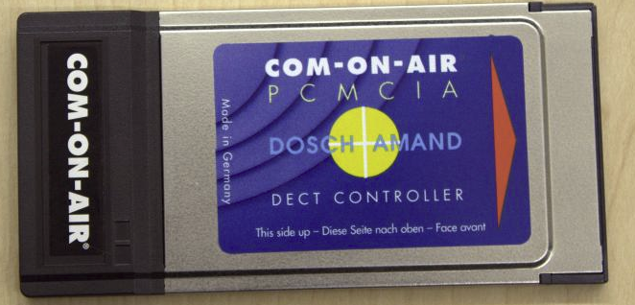
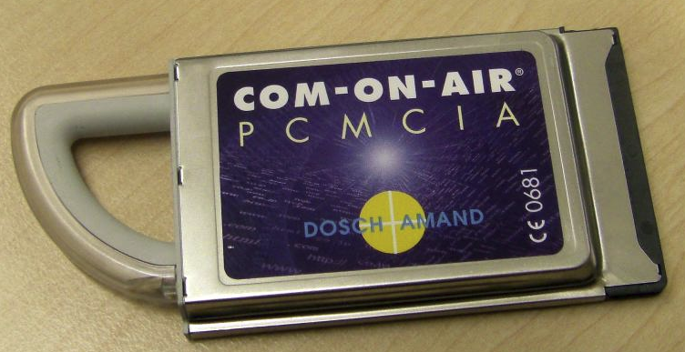
Equipment we need
Old school: Com-on-air PCMCIA card
COM-ON-AIR was the name or multiple DECT products build by Dosch Amand. Most interesting here are PCMCIA DECT cards, which are still available. These cards ship with a windows driver which allows you to create a DECT base station on a windows PC. You can connect DECT phones to this base station, and the base station will register at a SIP provider and allow all phones to make VOIP calls over this SIP provider and route incoming VOIP calls to these phones.
PCMCIA Type II: Hundreds of Dollars
PCMCIA Type III: About $100+

Slide 26
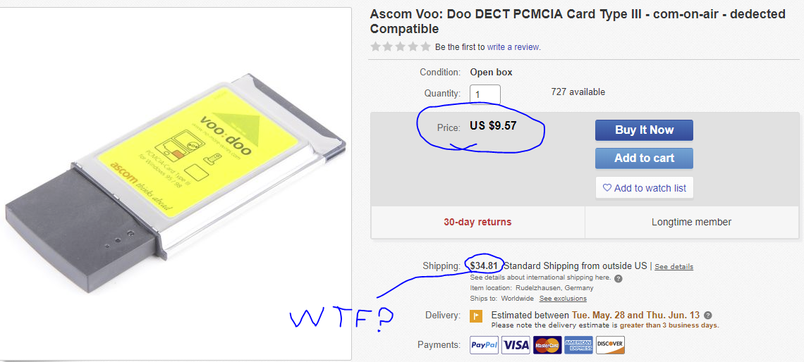
Equipment we need
For the real cheap-asses:
Ascom Voo:Doo and Telefonica are two cheaper alternative that is also compatible for dedected, and cost about $50. The downside is that the antenna is much weaker.

Slide 27
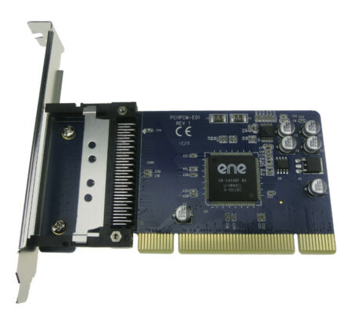
Setup
Biggest challenge is getting this thing to work
Laptops with PCMCIA Type III slots are hard to find. USB to PCMCIA adapters are not common and I don’t trust them to work.
Opted for PCI to PCMCIA pass-through

Slide 28
Setup
Biggest challenge is getting this thing to work
Cloned deDected software can be found on GitHub: https://github.com/LucaBongiorni/dedected or at the original site dedected.org
CHAOX Live-CD includes Dect software pre-configured: https://chaox.wordpress.com/2009/07/04/chaox-2009-7-is-here/#more-162
Confirm that Linux sees the PCMCIA card with “lspcmcia” or “pccardctl ls”
git clone https://github.com/LucaBongiorni/dedected
cd dedected/com-on-air-cs-linux/
make && make -C tools
make node

Slide 29
deDECTed software
The deDECTed software includes the following:
com-on-air-cs-linux Linux tools for DECT sniffing
Metasploit module to detect DECT calls
Dectshark – outputs DECT traffic to a PCAP
Pcapstein to convert PCAPs
Patches for a WireShark DECT dissector (now standard in new version of WireShark)

Slide 30
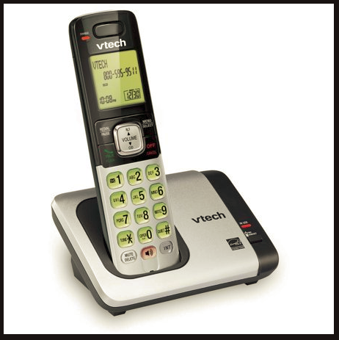
Target Phone #3: VTech CS6719
Released 2012
Still manufactured as of 2019
1.921536 – 1.928448 GHz
GFSK Modulation is used (all DECT 6.0 uses this)
DECT 6.0 Technology
FCC ID: EW780-9066-00

Slide 31
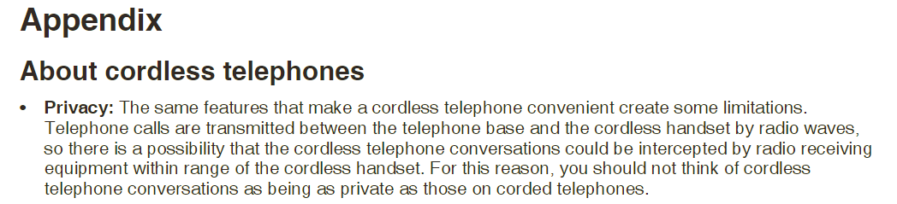
Vtech CS6719
Liability? Negligence? RTFM!

Slide 32
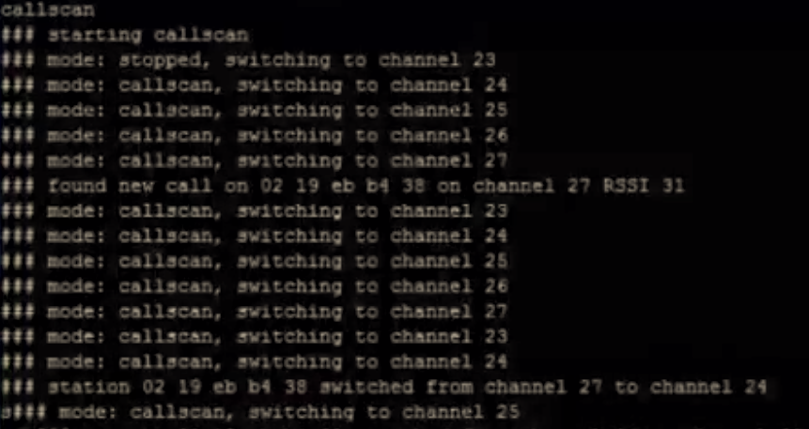
Attacks – Scanning and Eavesdropping
Using the dect_cli tool (part of com-on-air-linux), we can scan for base stations.
dect_cli (runs the DECT CLI tool)
verb (verbosity for more info)
fpscan (scans for Fixed Parts, AKA base stations)
ppscan (scans for PP, Portable Parts)
callscan (scans for active calls, which gets
outputted to audio)

Slide 33
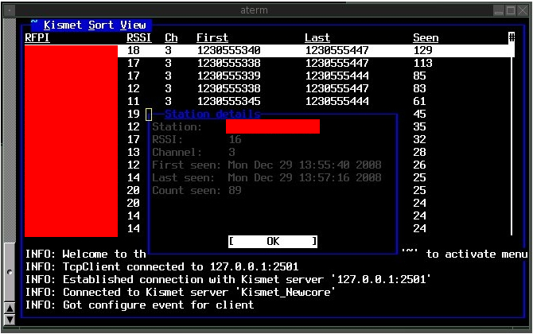
Attacks – War Driving with Kismet
A very specific version of kismet supports a DECT module that can be used for War Driving.

Slide 34
Software Defined Radio Approach
Since using the PCMCIA card is a pain and can be quite expensive, software defined radio tools can also be used. However, not all of the functionality of the original DECT software has yet to be made for SDR.
Development on the original deDECTed software died off in 2009-ish.
Even in 2019 there are few tools to listen to DECT.
The two most supported SDRs are the HackRF and the E4000 RTL-SDR.

Slide 35
Dumping PCAPs with re-DECTed
Re-DECTed, using either a HackRF/BladeRF/E4000 RTL-SDR will dump DECT data to PCAPs for us to analyze with the help of GNURadio.
git clone https://github.com/znuh/re-DECTed.git
cd re-DECTed/SDR
make
sudo modprobe dummy
sudo ifconfig dummy0 up
./dectrcv
Open another terminal and run ./dectrx.py
Open Wireshark and sniff the dummy interface

Slide 36
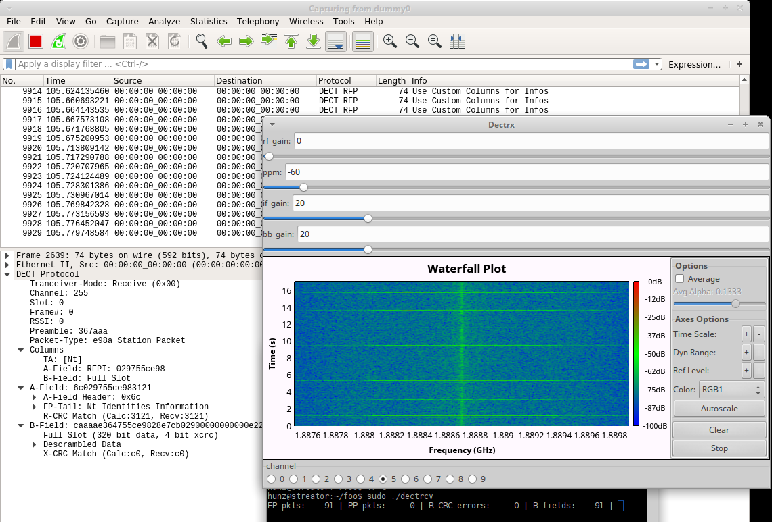
Dumping PCAPs with re-DECTed

Slide 37
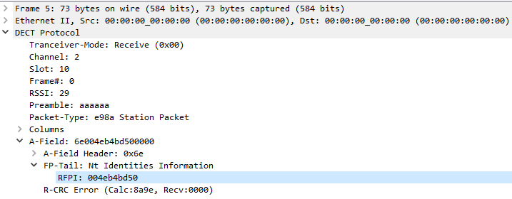
PCAPs – So What?
PCAPs allow us to see all the A-Field information. This is split out nicely due to the dissector.
Unfortunately we can’t listen to an actual voice conversation in WireShark like we can with VoIP :(

Slide 38
Converting PCAPs to WAV files
Using the older com-on-air-cs-linux tools, we can convert the PCAP with “pcapstein”, which extracts the G.726 audio from the PCAP into to two .ima files, one of the FP and one for the PP. It then needs to be piped through sox to be converted to a WAV file.
./pcapstein test.pcap
wget -q http://www.ps-auxw.de/g72x++.tar.bz2
tar xfj g72x++.tar.bz2
cd g72x && ./build.sh
decode-g72x -4 -a test_fp.ima | sox -r 800 -1 -c -A -t raw - -t wav test_fp.wav

Slide 39
Using GR-DECT2
GR-Dect2 is a GNU Radio flowgraph we can use with a Software Defined Radio to easily decode DECT signals.
Signals Everywhere AKA Corrosive, has a fork of GR-DECT2 that supports American channels, as well as European channels.

Slide 40
GR-DECT2 install commands:
sudo apt-get install git cmake gnuradio gr-osmosdr doxygen swig -y
git clone https://github.com/signalseverywhere/gr-dect2.git
cd gr-dect2
mkdir build
cd build
cmake ../
make install
ldconfig

Slide 41
GR-DECT2 install commands:
A lot of people (including myself) have had issues with getting the flowgraph working. I recommend a fresh ISO of Xubuntu 16.04 LTS, as it worked with no issue.
If you are running in a VM (not recommended), you should use the two following commands, as the volk profile will better optimize your VM. It is also recommended to have as much CPU power as possible.
sudo apt-get install libvolk1-bin
volk_profile

Slide 42
GR-DECT2
We will have to first identify our channel, then choose the appropriate slot for either the FP or PP. Unfortunately they move around a lot so we must manually pick each slot.
It’s not much but is a start in the right direction.
My sound quality is awful because VM + Low CPU + recording with OBS

Slide 43
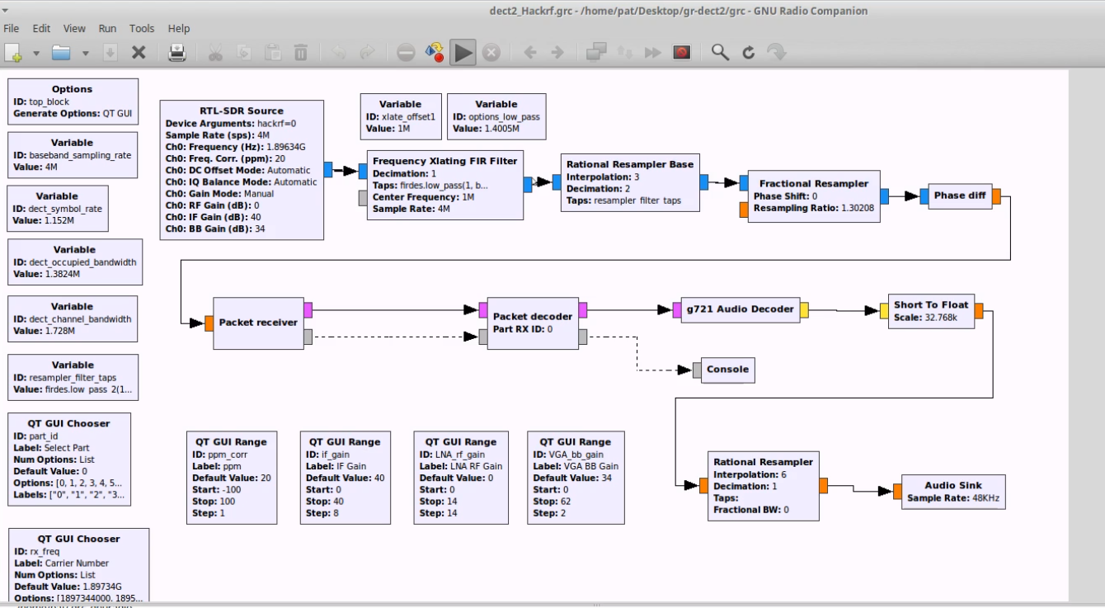
GR-DECT2

Slide 44
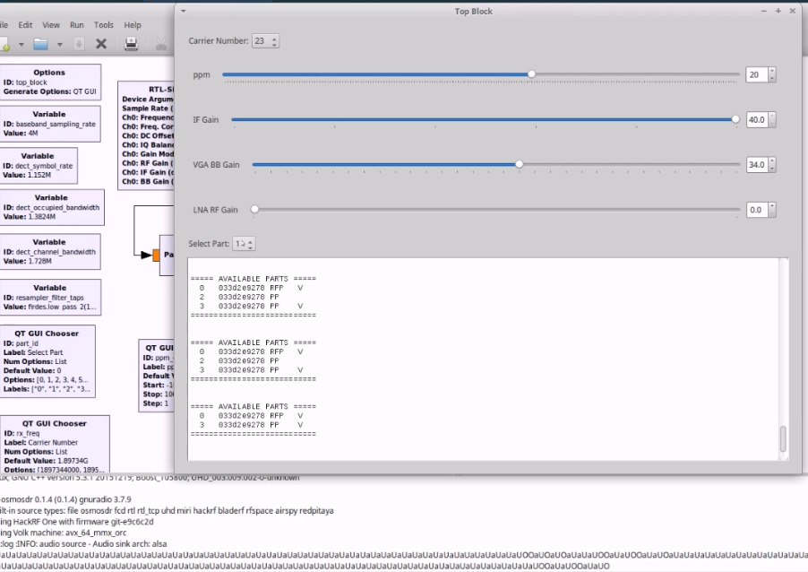
GR-DECT2

Slide 45
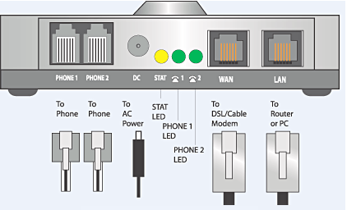
Do you have cordless landlines in your Environment?
Even large organizations may have standard landline phones for emergencies/backup if VoIP fails.
Analog Voice Gateways and Analog Telephony Adapters (ATAs) may be present in your environment, allowing RJ11 style phones to connect to your VoIP network.

Slide 46
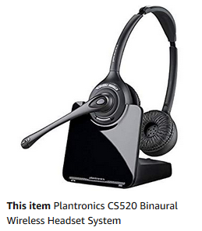
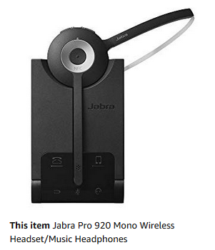
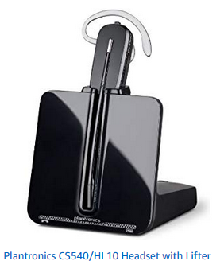
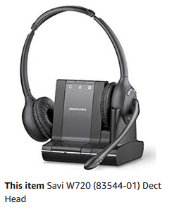
DECT Headsets
As 2.4GHz is crowded, some technology opts to use DECT.
The DECT forum will certify DECT devices: https://www.dect.org/security-certification.aspx

Slide 47
Future of DECT
2009 estimate claimed their to be over 600 million DECT devices
As IoT grows, some may turn to DECT to avoid crowded frequencies
DECT 6.0 phones are still manufactured and sold. Some phones may be marketed as “DECT 6.0 Plus”
NG-DECT/CAT-iq – mandatory support for enhanced security

Slide 48
Conclusion
Analog and non-encrypted digital phones are not secure and should not be used
DECT 6.0 devices may not enforce encryption and may not be secure
DECT 6.0 Plus is a better option
Check to see if your devices are DECT Security Certified
Corded-landlines are preferable is using landline
Physical wiretapping may be occurring upstream
2G/3G/4G Cell phones have their own security issues

Slide 49
Links
https://dedected.org/trac
http://www.dectweb.com/Introduction/intro.htm
http://dect.osmocom.org/
http://www.hackingexposedwireless.com/chapters/ch05.pdf
https://www.dect.org/userfiles/Public/DF_DECT%20Security%20Certification.pdf

